Slide 1



SMART CROP DISEASE DETECTON AND ACTION
Presented By
Guided By
Mr.L.Ramesh, M.E., (Ph.D)
CHANDIKA K (927623BEC020)
DEEPIKA S (927623BEC023)
DEEPIKAA V (927623BEC024)
DHARANI S (927623BEC029)

Slide 2
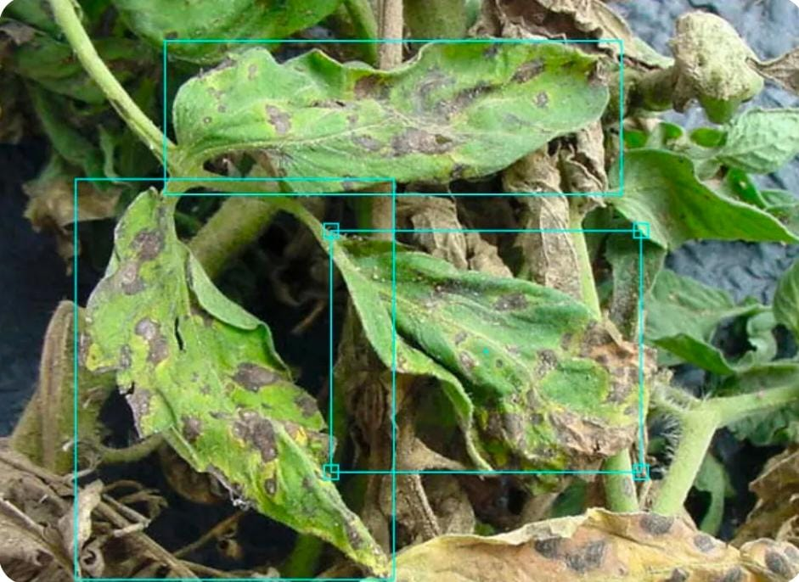
PROBLEM STATEMENT
Farmers face major challenges in detecting crop diseases early because manual observation is slow, inaccurate, and dependent on experience. Environmental changes make timely diagnosis even harder. A smart system using sensors and AI is needed to monitor crop conditions continuously, identify diseases with high accuracy, and deliver early alerts and corrective actions to prevent large-scale yield loss.

Slide 3
OBJECTIVES
Enable early detection of crop diseases using AI-based image analysis
Provide continuous monitoring of crop health through IoT sensors
Reduce manual inspection effort by automating disease identification
Ensure safe pesticide usage by verifying expiry before spraying
Improve crop yield through timely alerts and corrective actions
Minimize resource wastage in irrigation and spraying
Support farmers with real-time decision-making information

Slide 4
SCOPE OF THE PROJECT
Covers real-time sensing of temperature, humidity, soil moisture, and light
Includes image-based disease classification using a lightweight CNN model
Integrates automated spraying, irrigation, and alert notification systems
Operates through IoT connectivity for remote monitoring and data logging
Provides historical data records for trend analysis and future planning
Supports multiple crop types with scalable sensor and AI modules
Applicable for small farms, large fields, and greenhouse environments

Slide 5
EXISTING SYSTEM
Manual crop inspection is time-consuming and often inaccurate.
Farmers rely on experience, delaying early disease detection.
Some systems use only image processing for disease detection.
IoT sensors monitor environment but lack AI decision support.
Traditional spraying applies chemicals uniformly, wasting resources unnecessarily.
Mobile apps exist but provide limited real-time actionable recommendations.
Historical data analysis is rarely integrated into existing systems.

Slide 6
PROPOSED SYSTEM
A network of environmental sensors continuously measures temperature, humidity, soil moisture, and light intensity to monitor crop conditions in real time.
A camera module captures leaf images, which are processed by a lightweight CNN model for high-accuracy disease classification.
The system verifies pesticide expiry and automatically triggers the sprayer or irrigation pump based on disease detection or low soil moisture.
All sensor data, image results, and system actions are logged to the cloud for real-time alerts and farmer notifications.
The platform enables automated decision-making, reducing manual intervention and improving crop protection efficiency.
.

Slide 7
LITERATURE SURVEY
S.NO | AUTHOR | TITLE | YEAR | REMARKS
[1] | P. Gupta | Deep Learning for Real-Time Plant Disease Diagnosis | 2021 | Explains the evolution of Convolutional Neural Networks (CNNs) for identifying various crop diseases from leaf images, detailing how high-accuracy models improve diagnostic speed and efficiency in the field.
[2] | S. Khan | Adaptive IoT Sensor Networks for Precision Agriculture | 2022 | Describes how low-power environmental sensors are integrated via IoT protocols to provide crucial contextual data, enabling predictive disease modeling and stable data transmission under varying field conditions.
[3] | L. Zhou | Multi-Modal Sensor Fusion for Early Crop Stress Detection | 2023 | Demonstrates the importance of combining visual data with environmental sensor data to detect pre-symptomatic stress in plants, essential for true early warning and optimized intervention.
[4] | M. Singh | Edge Computing in Automated Pest and Disease Control 2023 | 2023 | Highlights the importance of processing AI models directly on edge devices (e.g., in-field cameras) to enable immediate detection and action, reducing reliance on constant cloud connectivity and minimizing latency for real-time alerts and spraying.

Slide 8
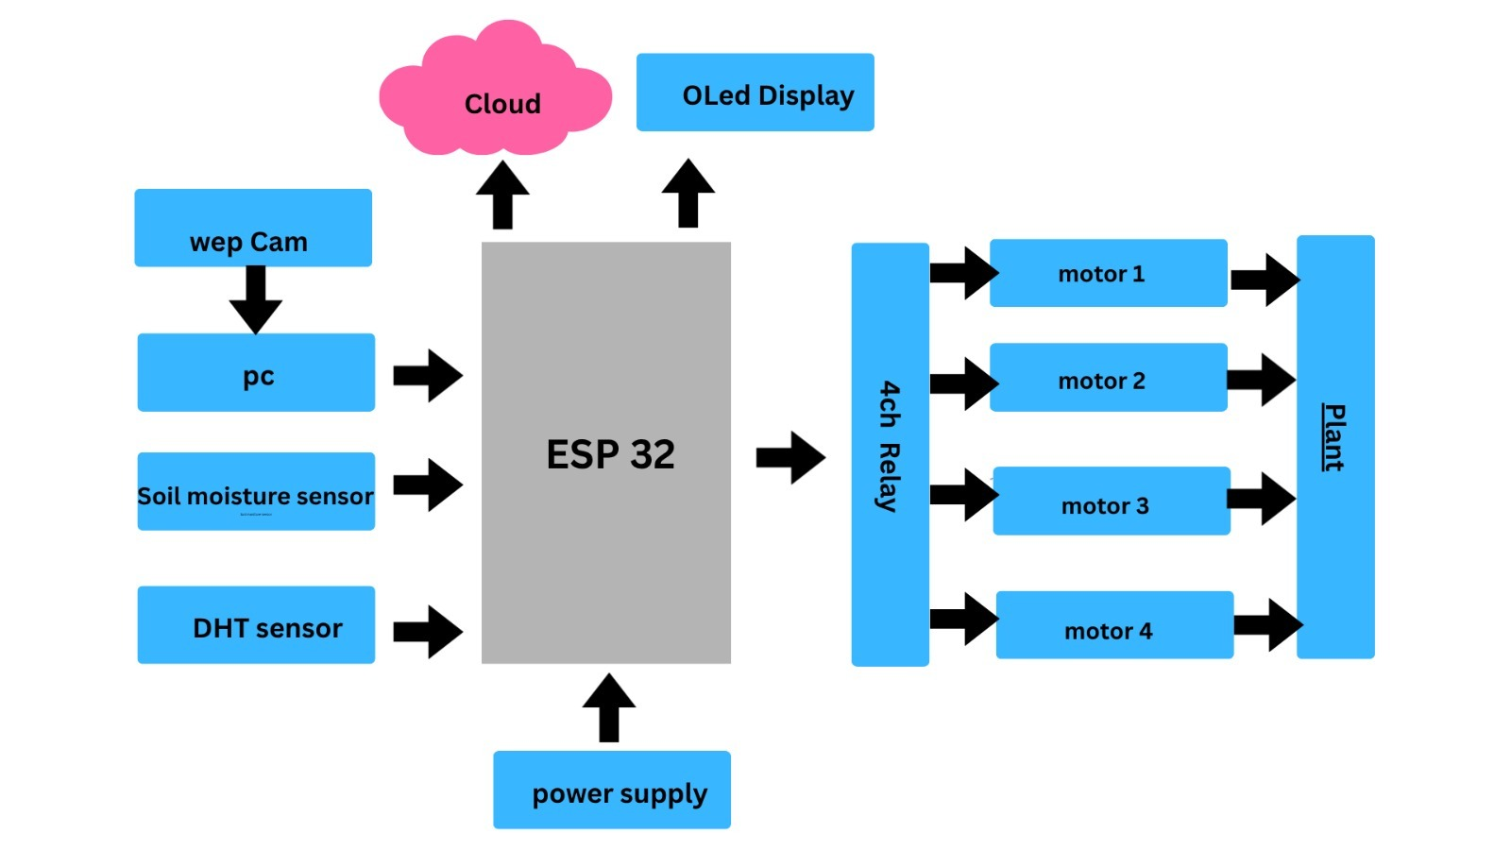
BLOCK DIAGRAM

Slide 9
METHODOLOGY
The system operates by continuously acquiring real-time environmental data from temperature, humidity, soil-moisture, and light-intensity sensors, which are processed through the ESP32 microcontroller for condition assessment. A camera module captures leaf images, and these images are preprocessed using noise filtering, resizing, and normalization techniques before being analyzed by a lightweight CNN model trained for multi-class disease detection. When the model identifies abnormal symptoms or when sensor readings cross predefined thresholds, the controller triggers the required actuators such as irrigation pumps or pesticide sprayers. All operational data, including sensor logs, detection outcomes, and actuator activity, are transmitted to the cloud for monitoring and stored for further analysis. Alerts and system notifications are delivered to the farmer through an IoT communication interface, enabling timely decisions and continuous remote supervision.

Slide 10
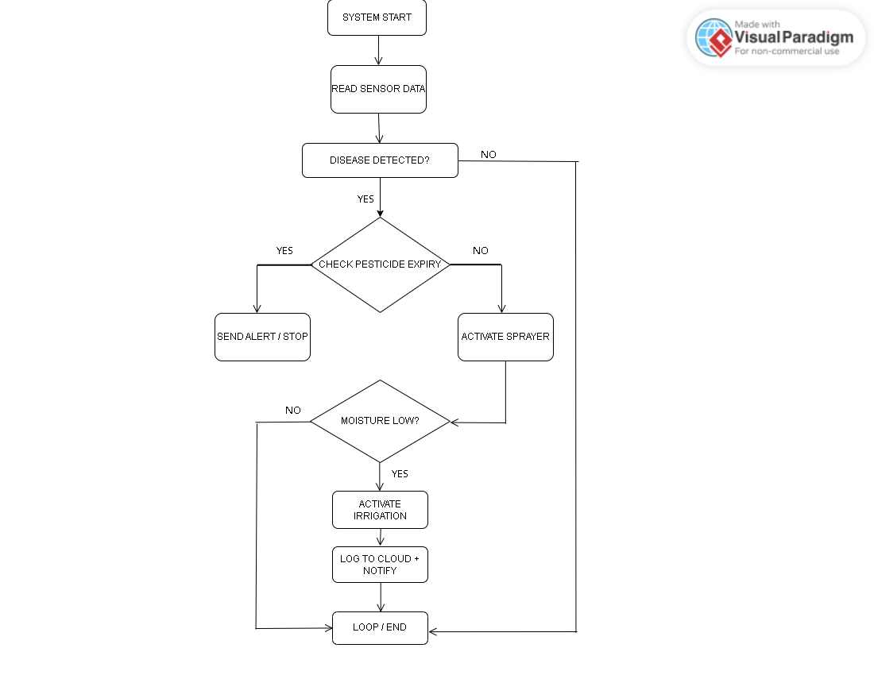
FLOWCHART

Slide 11
HARDWARE AND SOFTWARE USED
ESP32 Board – Main controller with Wi-Fi/Bluetooth for system automation.
5V Power Supply – Powers relays and pumps safely.
DHT11 Sensor – Measures temperature and humidity (digital).
Soil Moisture Sensor – Detects soil wet/dry condition.
DS3231 RTC – Provides accurate real-time clock for scheduling.
4-Channel Relay Module – Controls pumps and sprayers.
Water Pump – Provides irrigation when triggered.
Float Level Sensors – Monitors water levels in main and sprayer tanks.
USB Webcam – Captures leaf images for disease detection.
Blynk Cloud / IoT Platform – Used for real-time monitoring and control

Slide 12
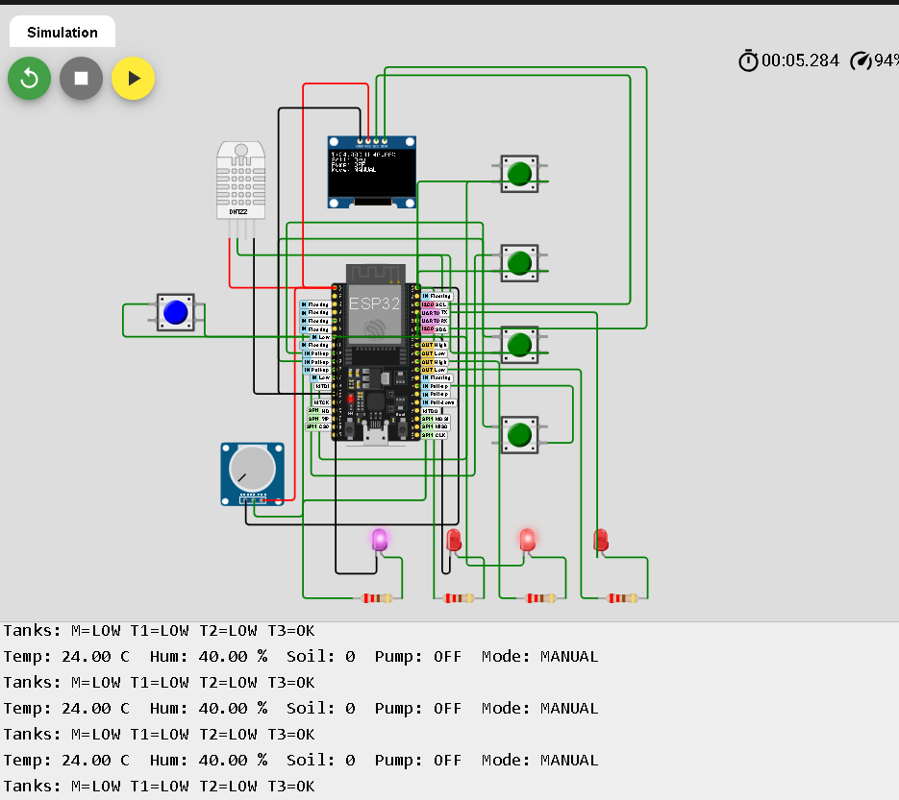
SIMULATION RESULT

Slide 13
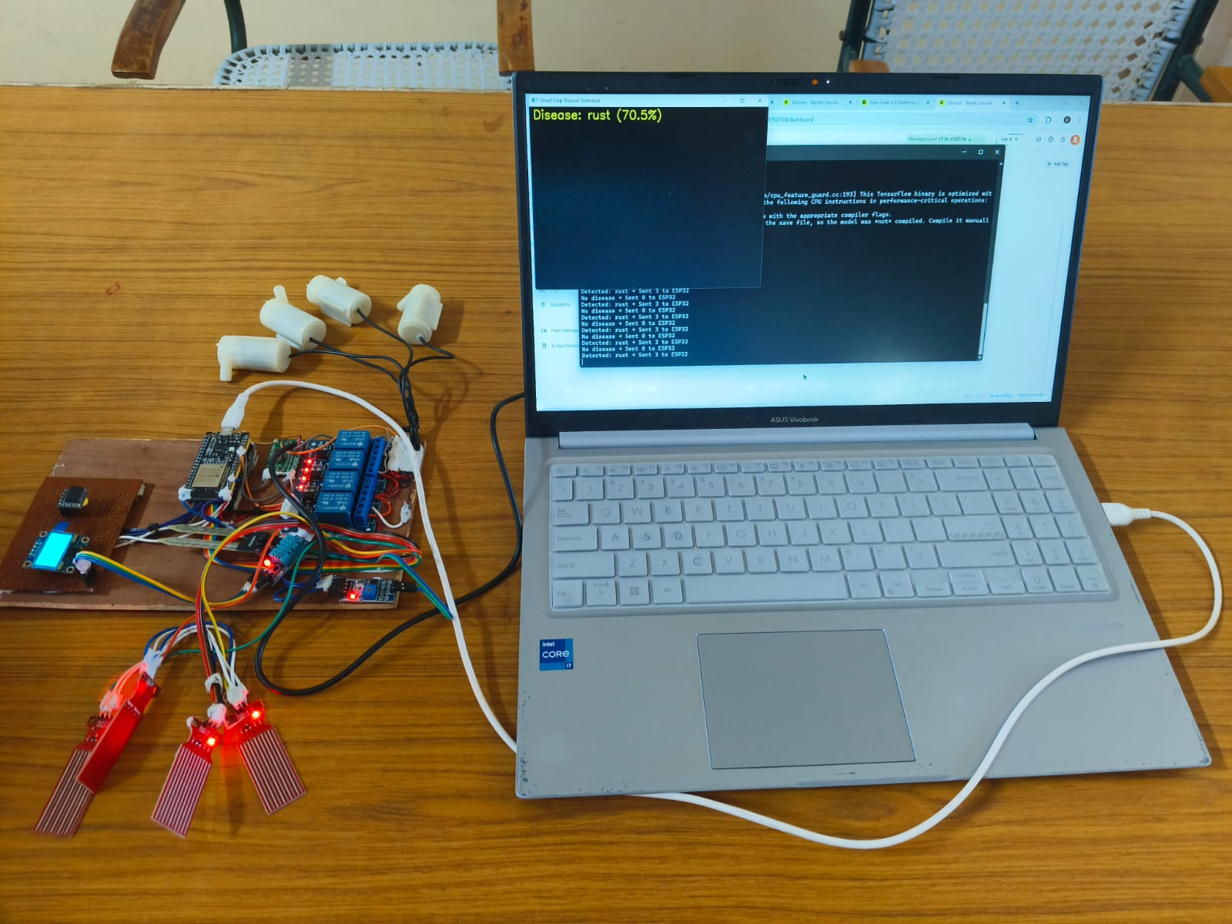
HARDWARE PROTOTYPE

Slide 14
RESULTS & DISCUSSION
The implemented system successfully detected abnormal environmental conditions and crop diseases with a high level of reliability. The sensor network continuously measured temperature, humidity, soil moisture, and light intensity, and the collected data showed stable real-time performance without delays. The CNN-based image classifier accurately identified disease symptoms from leaf images and triggered the appropriate response actions. Automated control operations—such as pesticide spraying and irrigation—were activated only when required, proving the efficiency of the decision-making logic. Overall, the system demonstrated consistent performance in early detection, reduced manual intervention, and improved precision in crop management.

Slide 15
APPLICATIONS
Real-time crop health monitoring in agricultural fields for early detection of diseases.
Automated pesticide spraying based on AI-driven disease identification to reduce chemical wastage.
Smart irrigation activation using environmental and soil-moisture analysis.
Greenhouse monitoring systems where controlled environmental sensing improves crop stability.
Precision agriculture platforms that integrate IoT data and machine-learning predictions for optimized yield.
Agri-based decision-support systems providing actionable insights to farmers through mobile alerts.
Large-scale farm automation for reducing manual labor and ensuring continuous surveillance of crops.

Slide 16
Minimized Crop Loss: Early AI-driven detection and automated corrective action significantly reduce the spread and impact of crop diseases.
ADVANTAGES
Accurate disease identification through AI-based image analysis.
Automated system actions such as spraying and irrigation using integrated sensors.
Real-time environmental monitoring for improved data-driven crop management.
Minimized Crop Loss: Early AI-driven detection and automated corrective action significantly reduce the spread and impact of crop diseases.
LIMITATIONS
Environmental Sensitivity: Variations in lighting, camera angle, or weather conditions can affect image quality and reduce detection reliability.
Hardware Dependence: Continuous monitoring requires stable power, sensor calibration, and connectivity, making the system less effective in remote areas.

Slide 17
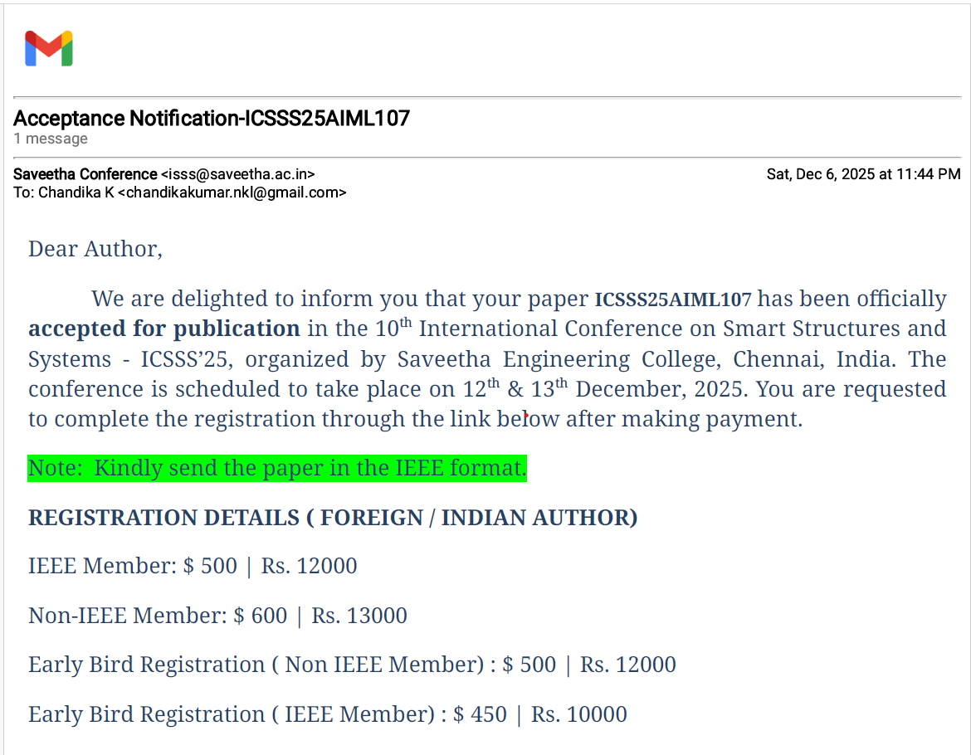

PROJECT OUTCOME

Slide 18
FUTURE SCOPE
Integration of drone-based imaging for large-area, high-resolution crop monitoring.
Deployment of edge-AI hardware to perform faster, on-device disease classification without cloud dependency.
Expansion of the model dataset to include more crop varieties and emerging diseases for higher detection accuracy.
Implementation of predictive analytics to forecast disease outbreaks using long-term sensor and weather data.
Addition of automated nutrient management using soil analysis and fertilizer-control modules.
Real-time farm-to-cloud dashboard for multi-field monitoring and remote agronomic decision-making.

Slide 19
CONCLUSION
The AI-powered Crop Disease Detection and Action system helps farmers spot diseases in their crops at a very early stage, allowing them to take quick and correct actions. Instead of relying only on manual checking, the system uses cameras and sensors to constantly watch the crops and identify even small symptoms that humans might miss. This early detection keeps the plants healthier, improves yield, and reduces the amount of fertilizer or pesticide that gets wasted. It also saves a lot of time and effort for farmers because the monitoring is fully automated and works in real time. By giving accurate suggestions for treatment and reducing unnecessary manual work, the system supports smarter and more sustainable farming. Overall, it reduces crop loss, improves productivity, and helps strengthen food security

Slide 20
REFERENCE
[1] P. Gupta, “Real-Time Plant Disease Identification Using CNN-Based Deep Learning Models,” in Proc. IEEE Int. Conf. on Computational Intelligence and Communication Networks (CICN), 2021, pp. 1–6.
[2] S. Khan, “IoT-Based Adaptive Environmental Monitoring System for Precision Agriculture,” in Proc. IEEE Int. Conf. on Smart IoT Systems, 2022, pp. 45–52.
[3] L. Zhou, “Multi-Sensor Fusion Framework for Early Detection of Crop Stress Using Visual and Environmental Data,” IEEE Sensors Journal, vol. 23, no. 4, pp. 789–797, 2023.
[4] M. Singh, “Edge-AI Framework for On-Device Detection of Crop Diseases and Automated Pest Control,” IEEE Internet of Things Journal, vol. 10, no. 12, pp. 10345–10353, 2023.
[5] R. Sharma and A. Verma, “IoT-Enabled Smart Agriculture System for Real-Time Plant Health Monitoring and Automated Irrigation,” in Proc. IEEE International Conference on Internet of Things and Intelligent Systems (IoTIIS), 2023, pp. 112–118.

